Slide 1


SCRAP-VEND
TEAM MEMBERS
Mohammad Noman
Poornima Varshney
Aishwarya Phulwani
Saif Ali
An android app to sell your scrap.
Guided By
Miss. Rozy Verma

Slide 2


TABLE OF CONTENT
1
INTRODUCTION
2
MODULES DESCRIPTION Namely ADMIN, PICKUP PERSON and USER
3
FUNCTIONALITY OF EACH MODULE Screen-shots of the work-done till now.
4
REFERENCES

Slide 3
OUR APPLICATION PROVIDES A PLATFORM TO SELL SCRAP MATERIAL FROM YOUR LOCATION TO HELP RECYCLABILITY.

Slide 4
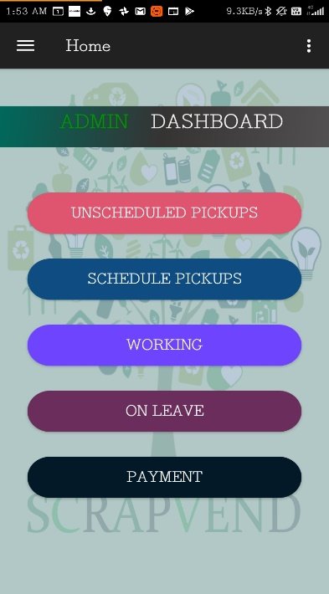
ADMIN MODULE
Add Or Update Item List
Keep Track Of Pickup Persons Working
View And Schedule Pending Pickups
Accept Or Reject Leave Request By Pickup Person
Add Or Remove Pickup Person
Track Pickup Status And Look History

Slide 5
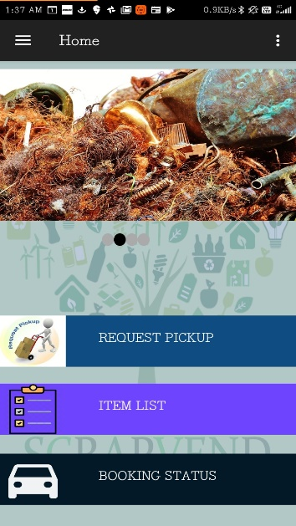
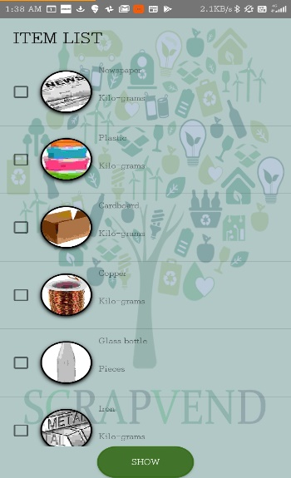
USER MODULE
BOOK A PICKUP REQUEST
CONTACT US
&
LOOK FOR ITEM LISTS
VIEW STATUS
MANAGE PROFILE
VIEW HISTORY

Slide 6
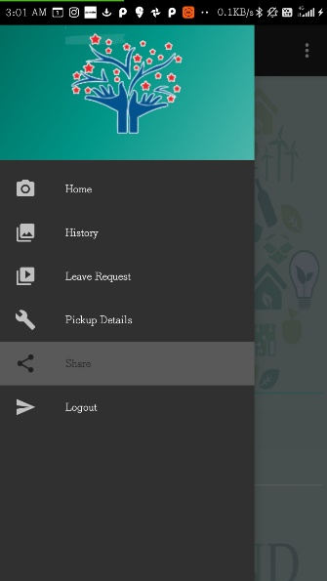
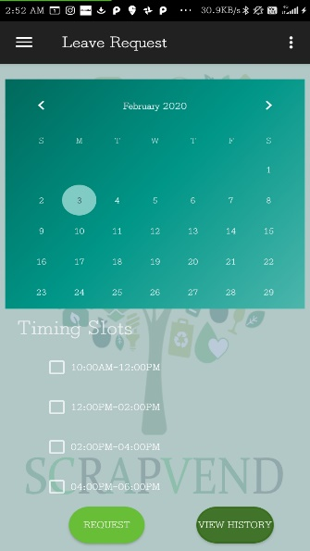
PICKUP PERSON MODULE
1.
VIEW PICKUPS ASSIGNED TO HIM
2.
REQUEST LEAVE
3.
VIEW HISTORY

Slide 7





REFERENCES
1
ANDROID DOCUMENTATION https://developer.android.com/guide/
2
REMOTE MY SQL https://remotemysql.com/
3
STACK OVERFLOW https://stackoverflow.com/
4
GITHUB https://github.com/mohammadn0man/scrapvend
5
TEXT LOCAL https://www.textlocal.in/
Last accessed on : 02/02/2020

Slide 8

THANK YOU
https://github.com/mohammadn0man/scrapvend

